Slide 1

AI Ethics, Security, and Confidence
Artificial Intelligence is transforming the world, but it's important to consider the ethical implications and ensure that we're building systems that are secure and reliable.

Slide 2
Ethical Considerations in AI
Algorithmic Bias
Data Bias
AI can perpetuate and amplify societal biases, leading to unfair outcomes and discrimination.
Unrepresentative, incomplete, or inaccurate data can distort AI predictions.
Misuse of Data
Transparency & Accountability
The collection, storage, and use of personal data raises ethical concerns about privacy and surveillance.
There's a need for greater transparency and accountability in how AI systems are developed and used.

Slide 3
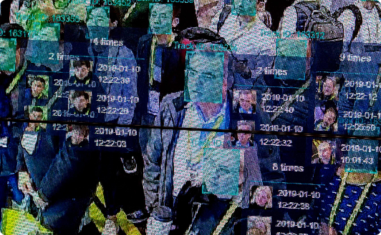


Examples of Ethical Concerns in AI
Facial Recognition
Self-Driving Cars
Automated Hiring Systems
Facial recognition technology can be used for mass surveillance, intruding on personal privacy and civil liberties.
Self-driving cars raise ethical questions about safety and responsibility in the event of an accident.
AI in hiring can perpetuate biases and lead to discrimination against certain groups.

Slide 4

Security and Privacy Implications of AI
1
Data Breaches
2
Cyberattacks
3
Malware & Viruses
The increasing use of AI means an increased risk of data breaches, which can be catastrophic for individuals and organizations.
AI can be used by malicious actors to carry out cyberattacks, posing a significant threat to national security.
AI can be used to create more advanced and sophisticated malware and viruses, making it harder to defend against cyber threats.

Slide 5
Building Confidence in AI Systems
Interpretability
AI systems should be transparent and explainable, so that users can understand how they work and trust their output.
1
2
3
Data Quality
Human Oversight
High-quality data is essential for building accurate and reliable AI models.
Human experts should be involved in developing and monitoring AI systems to ensure ethical and responsible use.

Slide 6
Ways to Increase Confidence in AI Models
Data Augmentation
Model Explainability
Human Opinion
Expand the amount and variety of data available for training AI models, reducing the risk of bias.
Introduce methods that enable insight into the decision making of AI-models.
Obtain human feedback on the performance of AI-models to identify weaknesses and improvements.

Slide 7

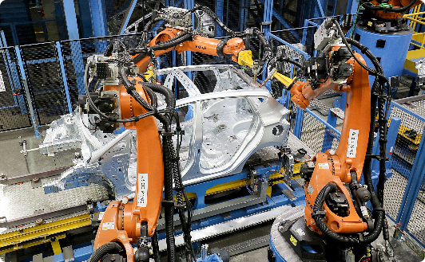

Real-world Applications and Case Studies
AI in Medicine
AI in Manufacturing
AI in Agriculture
AI is being used for medical diagnosis, drug development, and patient data analysis.
Robots powered by AI are automating assembly lines, reducing costs and increasing efficiency.
AI is being used to optimize crop yields, reduce waste, and minimize environmental impact.

Slide 8

The Role of Government and Industry in Promoting AI Ethics
1
Regulation
2
Education and Awareness
Government regulation can ensure ethical and responsible development and use of AI.
Awareness and education of the public and AI developers about the ethical implications of AI before integration.
3
Industry Initiatives
Industry initiatives can include codes of conduct, collaborations with government, and the establishment of AI ethics and safety standards.

Slide 9
Conclusion and Call to Action
Ethics First
Collaboration is Key
Transparency & Responsibility
As AI continues to grow in importance, it is our responsibility to prioritize ethical design and use.
Effective collaboration between government and industry is essential to ensure that AI is developed and deployed in a responsible manner.
Transparency and responsibility for AI are essential so that we can trust the benefits of better decision-making, increased efficiency and quality of life which AI offers.

